Slide 1
















whoami
Daniel Schwarz
lbschwarzd@fhstp.ac.at
Education:
Prof. Exp.:
Notes:
Hobbies

Slide 2
Overall Conditions
Grading
50% Lab
more about that in the first lab session
50% Theory
eCampus exam at the end of this course
You need to collect more than 25 of 50 points for a positive grade
Attendance
Needs to be recorded on eCampus
Breaks
Camera
Recording
Material
Released under CC Attribution-ShareAlike 4.0 International (CC BY-SA 4.0)
https://creativecommons.org/licenses/by-sa/4.0/
https://github.com/dschwarz91/websec-lecture
Notes:
Pausen: Standard 4x5min => 2x10 min auch ok?
=> wenn ihr zwischendurch wirklich Pause braucht, einfach melden.

Slide 3
Quiz Time
Notes:
2 und 3

Slide 4
Economy of Mechanism
------------------------
Fail-safe Defaults
------------------------
Complete Mediation
------------------------
Least Privilege
------------------------
Least Common Mechanism
------------------------
Separation of Privilege
------------------------
Open Design
------------------------
Psychological Acceptability
- Saltzer and Schroeder, 1975 – http://web.cs.wpi.edu/~guttman/cs557_website/papers/saltzer1975.pdf
https://adam.shostack.org/blog/the-security-principles-of-saltzer-and-schroeder/
Notes:
http://web.cs.wpi.edu/~guttman/cs557_website/papers/saltzer1975.pdf
https://adam.shostack.org/blog/the-security-principles-of-saltzer-and-schroeder/
EoM: KISS
FsD: Base access decisions on permission rather than exclusion. Damit rechnen, dass Fehler passieren -> trotzdem sicheres Verhalten -> Grundsätzlich verbieten, explizit erlauben. -> Security by Default.
CM: strict authorization checks
LP: only the really needed privileges
LcM: reduce communication path
SoP: at least two keys for criticals actions | alternative interpretation: dividing an application
OD: Security may not depend on the fact that nobody knows how it works
PA: must be useable for humans

Slide 5
Earn or give, but never assume, trust.
------------------------
Use an authentication mechanism that cannot be bypassed or tampered with.
------------------------
Authorize after you authenticate
------------------------
Strictly separate data and control instructions, and never process control instructions received from untrusted sources.
------------------------
Define an approach that ensures all data are explicitly validated.
------------------------
Use cryptography correctly.
------------------------
Identify sensitive data and how they should be handled.
------------------------
Always consider the user.
------------------------
Understand how integrating external components changes your attack surface.
------------------------
Be flexible when considering future changes to objects and actors.
- IEEE Center for Secure Design, 2014 – https://ieeecs-media.computer.org/media/technical-activities/CYBSI/docs/Top-10-Flaws.pdf
Notes:
Warum das ganze? -> Mapping auf Schwachstellen und Auswertung
QUIZ: “Principles”

Slide 6
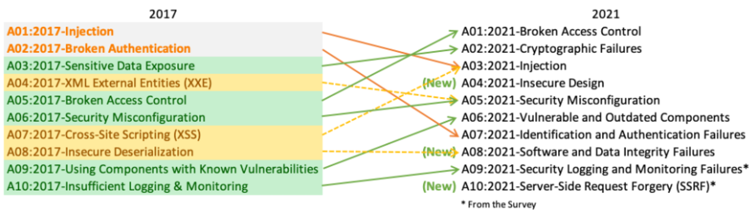
OWASP Top 10
https://owasp.org/www-project-top-ten/
https://owasp.org/Top10

Slide 7
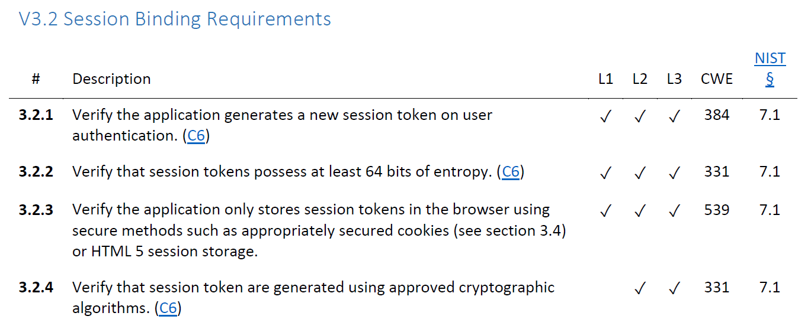
OWASP ASVS
V1: Architecture, Design and Threat Modeling Requirements
V2: Authentication Verification Requirements
V3: Session Management Verification Requirements
V4: Access Control Verification Requirements
V5: Validation, Sanitization and Encoding Verification Requirements
V6: Stored Cryptography Verification Requirements
V7: Error Handling and Logging Verification Requirements
V8: Data Protection Verification Requirements
V9: Communications Verification Requirements
V10: Malicious Code Verification Requirements
V11: Business Logic Verification Requirements
V12: File and Resources Verification Requirements
V13: API and Web Service Verification Requirements
V14: Configuration Verification Requirements
https://owasp.org/www-project-application-security-verification-standard/

Slide 8
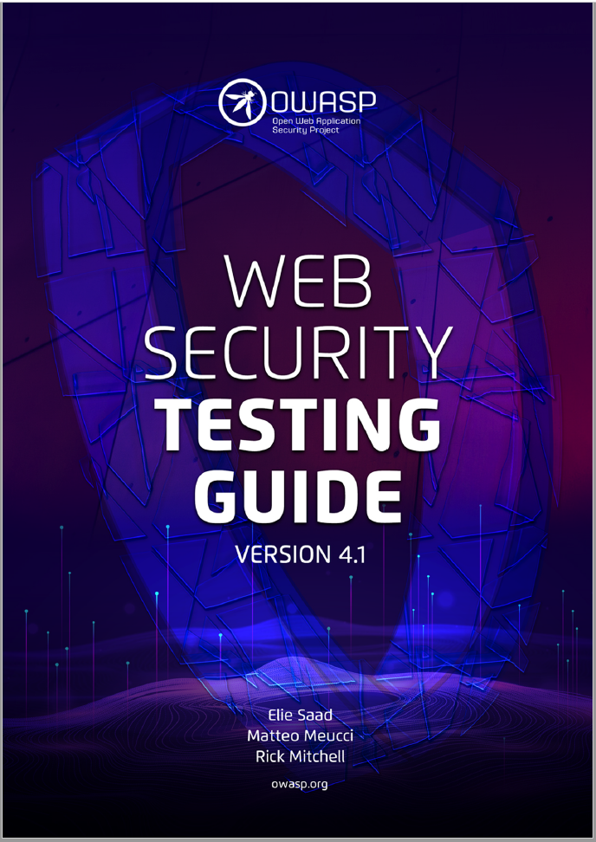
OWASP Web Security Testing Guide
https://owasp.org/www-project-web-security-testing-guide/

Slide 9

OWASP Cheat Sheet Series
https://cheatsheetseries.owasp.org/

Slide 10
Key Messages
Sticking to a few design principles helps to avoid a lot of flaws and vulnerabilities
they also help to find flaws and vulnerabilities
A lot of great resources are available when it comes to web security
OWASP is your friend

Slide 11












Slide 12
How do you access a website?
(except for googling it...)
You enter a URL
Uniform Resource Locator
and hit enter…
http://example.com:8080/demos/demo1.html?id=123&name=Luke#ref1
Protocol
Hostname
Port
Path
Query / Parameters
Fragment

Slide 13
DNS Hijacking | SQL Injection
Goal | Redirect user to a rogue server by manipulation of DNS records
How | Malware on client DNS server attack, e.g. DNS spoofing / cache poisoning MitM between client and DNS server Subdomain takeover
Solution | Hardening DNSSEC / TSIG Be aware of your subdomains
OWASP Top 10 | -
(Primary) Violated Principle | „Earn or give, but never assume, trust.“
Notes:
Is used by
- ISPs to display advertisement or collect statistics
Some Captive Portals for logon page
http://labsdetectify.wpengine.com/2014/10/21/hostile-subdomain-takeover-using-herokugithubdesk-more/

Slide 14
HTTP Request Verbs / Methods
classic.com/customers?id=12
restapi.com/customer/12
 | Safe / Idempotent | Intended Use | Intended RESTful Use
GET | Y / Y | Read | Read Resource
HEAD | Y / Y | Read (no body) | Read Resource Metadata
POST | N / N | Send something to the server | Create Resource
PUT | N / Y | Update something | Create/Update Resource
DELETE | N / Y | Delete something | Delete Resource
PATCH | N / Y | Update a part of something | Update Resource
CONNECT | N / N | Establish a tunnel | -
OPTIONS | Y / Y | List allowed verbs/methods | -
TRACE | Y / Y | Message loop-back test | -
https://developer.mozilla.org/en-US/docs/Web/HTTP/Methods
Notes:
REST = Representational State Transfer; Architekturstil / Abstraktion / einheitliche Schnittstelle / Zustandslos / URL-Path gibt Ort und Name der Ressource an
Connect: oft in Verbindung mit Proxies und HTTPS (https://developer.mozilla.org/en-US/docs/Web/HTTP/Methods/CONNECT)
Trace: Server spiegelt Anfrage wieder zurück (https://developer.mozilla.org/en-US/docs/Web/HTTP/Methods/TRACE)
=> man sieht z.B. was Proxies am Weg mit der Anfrage machen
Safe: doesn't alter the state of the server – read-only (https://developer.mozilla.org/en-US/docs/Glossary/safe)
Idempotent: if an identical request can be made once or several times in a row with the same effect while leaving the server in the same state – no side-effects (https://developer.mozilla.org/en-US/docs/Glossary/idempotent)

Slide 15
Information Disclosure | SQL Injection
Goal | Gather useful information – either for direct use or for further attacks.
How | two categories: - technical data - e.g. HTTP Header, unhandled errors, status, directory index, robots.txt - business data - authorization problems, SQLi, etc. – we will talk about that later
Solution | Webserver configuration hardening Error-Handling Secure Coding
OWASP Top 10 | A05:2021-Security Misconfiguration
(Primary) Violated Principle | „Identify sensitive data and how they should be handled.“

Slide 16
Plaintext Transmission (Info-Discl.) | SQL Injection
Goal | Read or modify data in transit
How | MitM between client and server - ARP Spoofing in your network (WIFI) or the servers' network - Malicious ISP (employee) - Gateways to foreign countries - DNS Hijacking - …
Solution | HTTPS (HTTP + SSL/TLS) HTTP/3 uses TLS 1.3 by default
OWASP Top 10 | A02:2021-Cryptographic Failures
(Primary) Violated Principle | „Earn or give, but never assume, trust. “

Slide 17
Transport Layer Security (TLS)
TLS = successor of SSL (Secure Socket Layer)
SSL 1.0 ~ 1994/1995
…
TLS 1.3 ~ 2018
Family of multiple protocols
Handshake, Change Cipher Spec., Alert, Application Data, Record
Builds an authenticated encrypted tunnel
Authenticates the accessed website (at least)
Protects the confidentiality and integrity of the data in transfer
HTTP over TLS = HTTPS (port 443 for https://)
HTTPS usage: https://transparencyreport.google.com/https/overview
PKI needed
Chain of trust ( > 1000 CAs & Intermediate CAs )
Notes:
Notiz für Zukunft: da TLS mittlerweile ein integraler Bestandteil des Webs ist könnte man es auch schon davor beim Verbindungsaufbau beschreiben.
https://transparencyreport.google.com/https/overview

Slide 18
Quiz Time
Notes:
4 TLS

Slide 19
PFS – Perfect Forward Secrecy
long-term secret is just used for authentication of session specific Diffie-Hellman Key Exchange
previous sessions cannot be decrypted, even if
one of the old session keys is compromised
the long-term secret (server’s private key) is compromised
most current TLS cipher suites implement PFS today

Slide 20
HSTS – HTTP Strict Transport Securtiy
Tells the browser to always use HTTPS for this site
e.g. for one year:
Strict-Transport-Security: max-age=31536000
Of course, first visit is still not secure
possible solution: HSTS Preload list
Strict-Transport-Security: max-age=63072000; includeSubDomains; preload
https://hstspreload.org/

Slide 22
HTML only
HTML + CSS
HTML + CSS + JS
gives you building blocks
and a basic structure
makes it „pretty“
party hard!

Slide 23
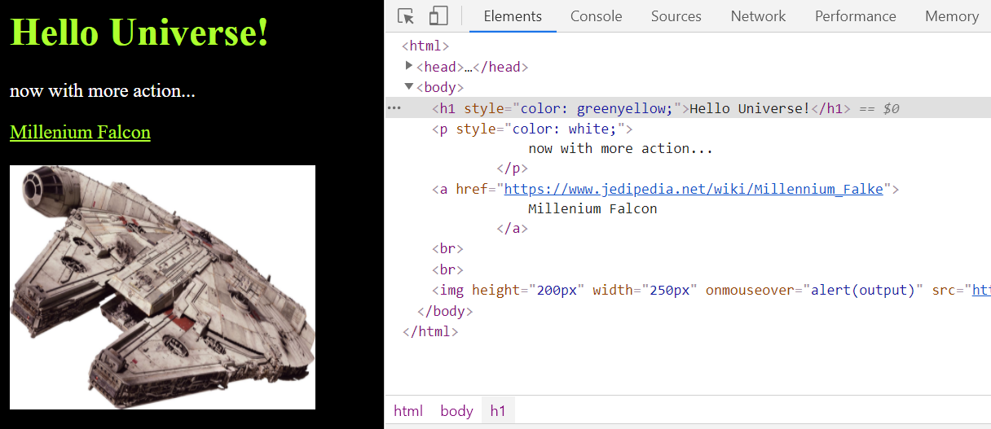
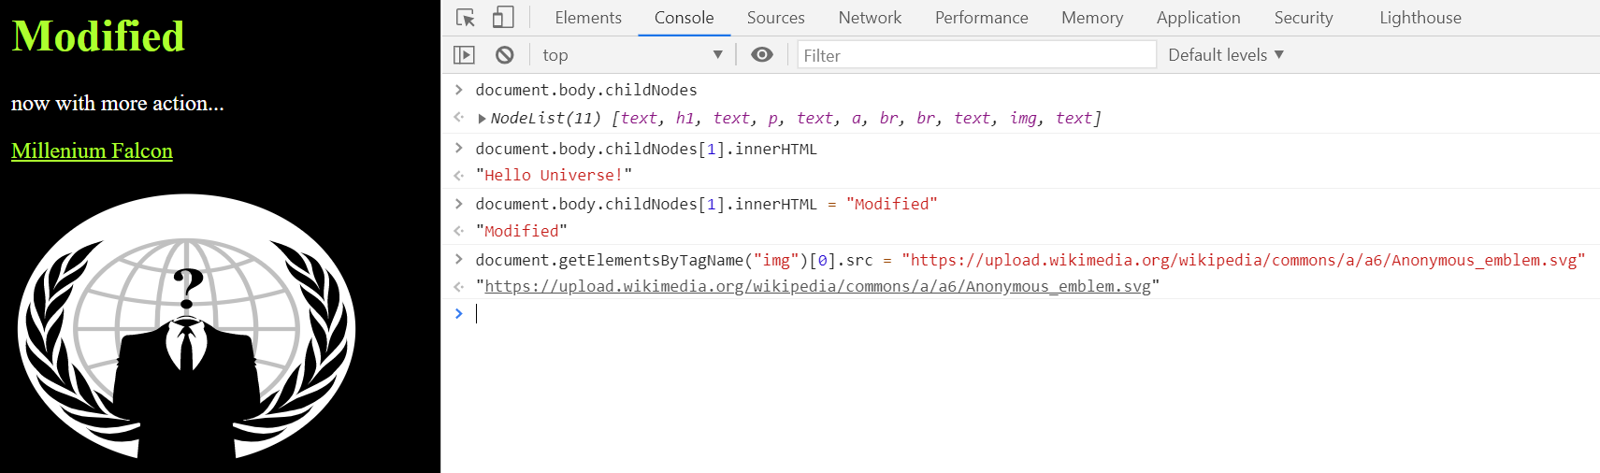

Slide 24
Key messages
HTTP is a stateless application-layer protocol based on requests and responses
It’s plaintext, so wrap it in well configured TLS
Harden your webserver properly

Slide 26
Quiz Time
Notes:
5 - 7

Slide 27
Notes:
Eigentlich mehr „von welchem user kommt der request“, denn darüber ob er wirklich der ist, der er angibt zu sein, sprechen wir ja gar nicht genau.
Auf Tonspur besprechen

Slide 28
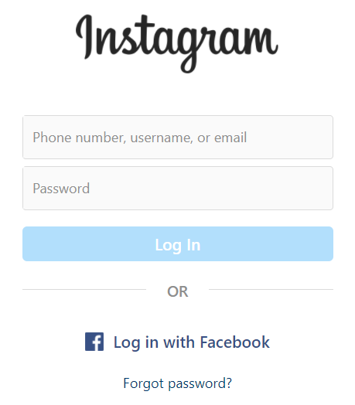

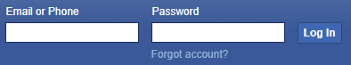

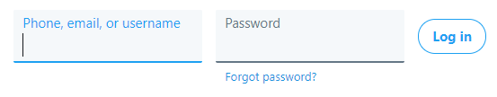
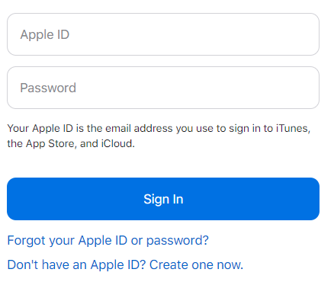
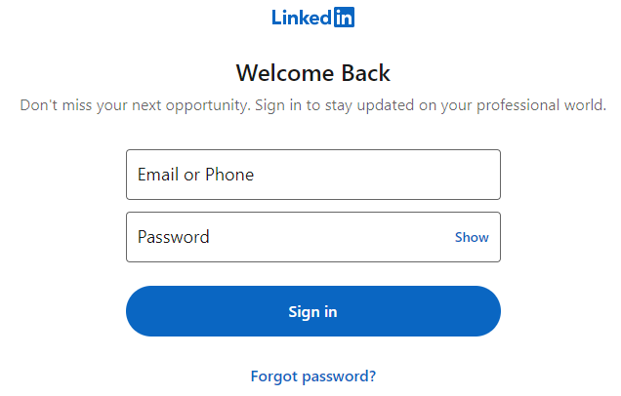
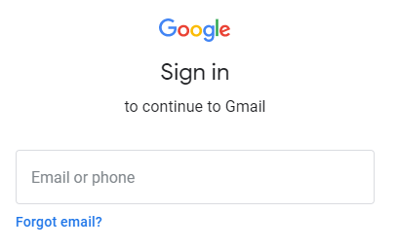
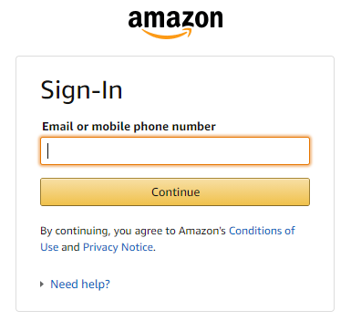
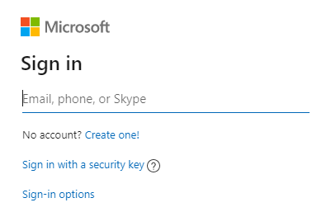

Slide 29
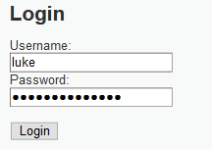


Form-based username/password auth
POST /shop/login.php HTTP/1.1
Host: lightside.me
...
username=luke&password=whoismyfather%3F
HTTP/1.1 200 OK
...
<some html site>
do you see any problems?

Slide 30
Plaintext Transmission (again) | SQL Injection
Goal | Read credentials in transit
How | MitM between client and server - ARP Spoofing in your network (WIFI) or the servers' network - Malicious ISP (employee) - Gateways to foreign countries - Spoofed Server (DNS Hijacking) - …
Solution | HTTPS (HTTP + SSL/TLS) HTTP/3 uses TLS 1.3 by default
OWASP Top 10 | A02:2021-Cryptographic Failures
(Primary) Violated Principle | „Earn or give, but never assume, trust. “

Slide 31
Authentication Automation Attacks | SQL Injection
Goal | Guess/Crack the user‘s credentials (e.g. username / password)
How | Brute Force Attacks Dictionary Attacks Credential Stuffing …
Solution | Generic Error Messages - Also consider this for the registration Anti-Automation Techniques - Captcha, tmp. Lockout, Tarpit, etc. Password Complexity Requirements - Current recommendation: length > complexity MFA (maybe even passwordless) Compromised Credential Checking
OWASP Top 10 | A07:2021-Identification and Authentication Failures
(Primary) Violated Principle | „Use an authentication mechanism that cannot be bypassed or tampered with.“

Slide 32



Which Auth-Factors do you know?
increase security by combining different factors 2FA / MFA
you know
you have
you are
username/password, PIN, etc.
certificate, smartcard, token, etc.
fingerprint, iris,
venes, etc.

Slide 33
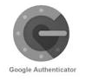

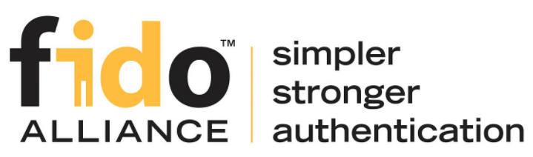
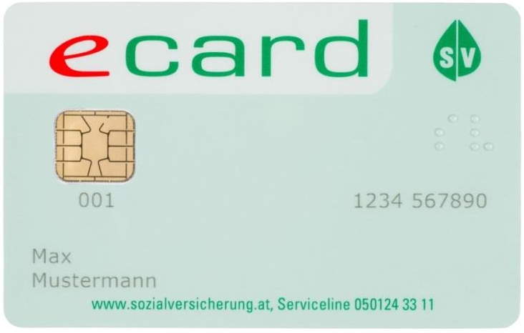

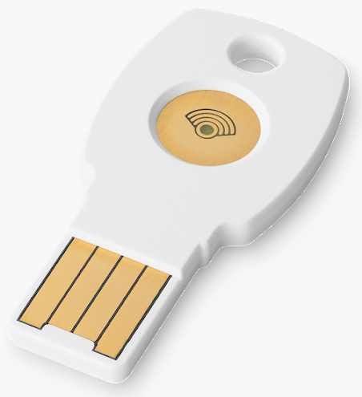
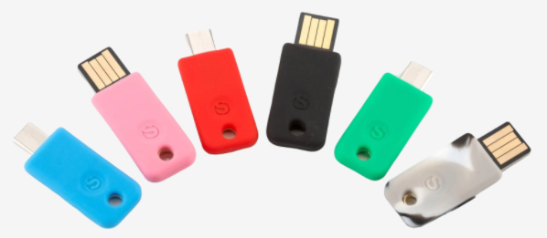
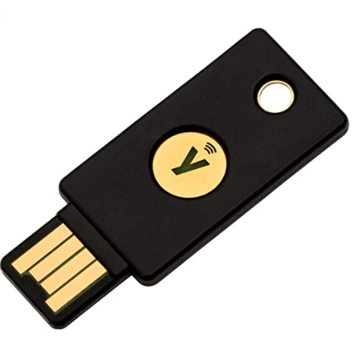

Options I personally really like…
TOTP
FIDO 2
Bürgerkarte
Time-based One-time Password
WebAuthN/CTAP U2F
Personal Smartcard in Austria
EOL
2019
=(
Notes:
TOTP und FIDO2/WebAuthN => Bsp: yubikey, solo-keys, google-titan
TLS-Clientzertifikate auch erwähnen
Hier nochmal darauf eingehen, dass eCard eine gewissen Level an Confidence mitgibt, dass es sich auch wirklich um diese Person handelt als die er sich ausgibt.
Leider mit Ende 2019 eingestellt -> man müsste sich jetzt eine separate A-Trust Karte bestellen.

Slide 34
Talking about credential stuffing…
how come those passwords got leaked in the first place?

Slide 35
Insecure Password Storage | SQL Injection
Goal | Steal user credentials
How | SQLi Server misconfigurations Malicious insider …
Solution | Use proper mechanisms to store credentials Special Password Hash Functions (PHF) or Password-based Key Derivation Functions (KDFs) – slow on purpose they use cryptographic hashes with large salt and high iteration count e.g. bcrypt, scrypt, PBKDF2, HKDF, Lyra2, [Argon2] etc.
OWASP Top 10 | A02:2021-Cryptographic Failures
(Primary) Violated Principle | „Use cryptography correctly. “

Slide 36
Passwords in Source Code | SQL Injection
Goal | Steal passwords of technical users
How | Error messages Logs Version control system (GIT, SVN, …)
Solution | bare minimum: put them in a config file Recommended solution heavily depends on platform, e.g. secret stores encrypted config files The „master key“ can be set e.g. via environment variable
OWASP Top 10 | A02:2021-Cryptographic Failures
(Primary) Violated Principle | „Identify sensitive data and how they should be handled.“

Slide 37
HTTP Basic Auth
Similar to form-based
Doesn‘t protect credential‘s confidentiality and integrity
Everybody can decode base64
Doesn‘t protect against server-spoofing
Needs HTTPS
User cannot manually logout
Application cannot force user to logout
Limited influence on password storage
depends on webserver
secure options available for most servers
e.g. Apache supports bcrypt
Notes:
Passworterstellung: https://en.wikipedia.org/wiki/.htpasswd
https://httpd.apache.org/docs/2.4/misc/password_encryptions.html

Slide 38
HTTP Digest Auth
Still doesn‘t really prevent MitM
Still doesn‘t really prevent server spoofing
Most security options are optional
Password is stored either in plaintext or MD5 hashed
both terrible
Just don‘t use it
If you really want to use HTTP auth:
Basic + HTTPS + Strong password storage mechanism
Notes:
Positiv: phishing nicht möglich -> Klartextpasswort wird ja nie übertragen
https://de.wikipedia.org/wiki/HTTP-Authentifizierung
https://security.stackexchange.com/questions/102833/flaw-in-http-digest-authentication
https://avdi.codes/the-trouble-with-http-digest-authentication/
https://en.wikipedia.org/wiki/Digest_access_authentication
https://httpd.apache.org/docs/2.4/mod/mod_auth_digest.html => password storage bei digest ist „less secure“ als bei basic
https://httpd.apache.org/docs/2.4/misc/password_encryptions.html

Slide 39
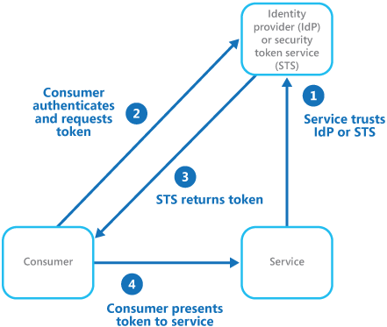
Identity Federation
or as microsoft describes it…
https://docs.microsoft.com/en-us/azure/architecture/patterns/federated-identity

Slide 40
pretty powerful to include some „environmental checks“
e.g. login attempt from foreign IP, login attempt from new/unknown device, multiple failed login attempts, etc.
notify the user if something is suspicious
a.k.a „conditional access“
Notes:
PINGO QUIZ (Authentication)

Slide 41

ok, we now know who this guy is…
… but HTTP itself is a stateless protocol
how can we remember this person between requests?

Slide 42
Sessions – Cookie based client side
POST /testlogin HTTP/1.1
Host: lightside.me
...
username=luke&password=whoismyfather%3F
HTTP/1.1 200 OK
Set-Cookie: username=luke
Set-Cookie: role=jedi
...
<some html site>

Slide 43
Sessions – Cookie based client side
POST /somerequest HTTP/1.1
Host: lightside.me
Cookie: username=luke; role=jedi
...
Cookie Store
lightside.me
username=luke role=jedi
do you see any problems?

Slide 44
Client-side Manipulation (of cookies) | SQL Injection
Goal | Manipulate data security checks depend on
How | Misplaced trust User has full control over his client and can manipulate everything on it!
Solution | Encrypt and sign cookie values Remaining Problem: Application cannot close all sessions of a user (e.g in case of compromise) ASP.NET ViewState works similar (hidden form field) JWT (JSON Web Tokens) also work similar Use Server-side Session Management
OWASP Top 10 | A01:2021-Broken Access Control
(Primary) Violated Principle | „Earn or give, but never assume, trust.“

Slide 45

Sessions – Cookie based server side
POST /testlogin HTTP/1.1
Host: lightside.me
...
username=luke&password=whoismyfather%3F
HTTP/1.1 200 OK
Set-Cookie: SESSID=n9ntoqopeu
...
<some html site>

Slide 46
Sessions – Cookie based server side
Cookie Store
GET /profile HTTP/1.1
Host: lightside.me
Cookie: SESSID=n9ntoqopeu
lightside.me
SESSID=n9ntoqopeu
HTTP/1.1 200 OK
Set-Cookie: SESSID=n9ntoqopeu
...
<some html site>
do you see any problems?

Slide 47
Session Hijacking | SQL Injection
Goal | Get victim‘s SID and hijack his session
How | Guessable SID MitM at insecure channel Firesheep (2010) SID in GET Parameter Logfiles, Browser history, Referrer header Steal SID via XSS we will cover this later
Solution | (Secure) Random generation with enough entropy bare min: >= 64 bit recommended: >= 128 bit Invalidate SIDs after a defined idle time HTTPS for whole communication not just login Secure flag Set-Cookie: SID=<ID>; Secure Send SID only in header or body Pay close attention to our XSS lecture later ;-)
OWASP Top 10 | A07:2021-Identification and Authentication Failures
Violated Principle | „Identify sensitive data and how they should be handled.“

Slide 48
what will the user‘s browser do?
HTTP/1.1 200 OK
...
<html>
<img src='https://www.jedibank.com/transfer?from=luke& to=vader&amount=3000'/>
</html>

Slide 49
he will just send the request as he is told…
5. GET /transfer?from=luke&to=vader&amount=3000 HTTP/1.1
Host: www.jedibank.com Cookie: SID=XXXX
6. HTTP/1.1 200 OK
and the sever will be happy to serve

Slide 50
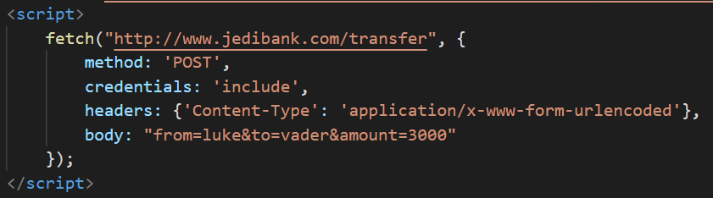
5. POST /transfer HTTP/1.1
Host: www.jedibank.com
Content-Type: application/x-www-form-urlencoded
Cookie: SID=XXXX
from=luke&to=vader&amount=3000
6. HTTP/1.1 200 OK

Slide 51
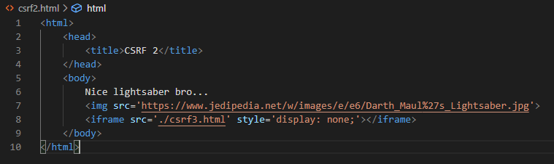
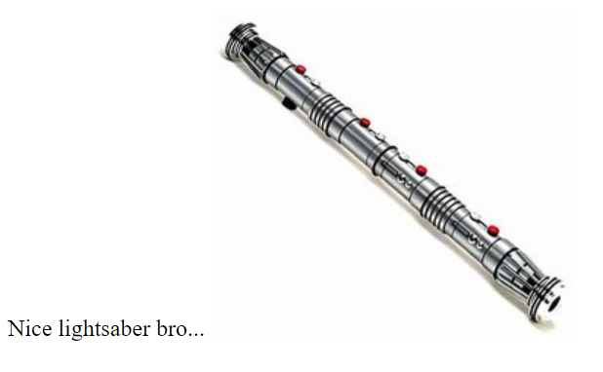
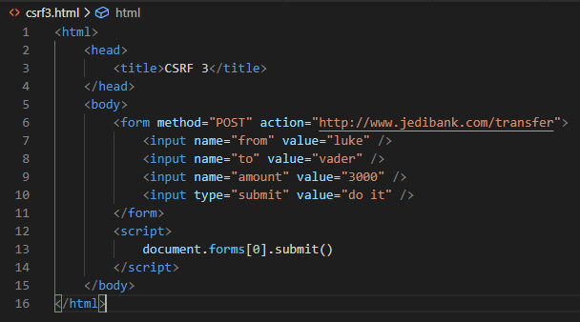
POST /transfer HTTP/1.1
Host: www.jedibank.com
Cookie: SID=XXXX
...
from=luke&to=vader&amount=3000

Slide 52
Internet
Company Network

Slide 53
Internet
Company Network
<img src='https://internalserver.intra:3000/somenastystuff'/>
especially bad if user is admin…

Slide 54
Internet
Home Network

Slide 55
Cross-Site Request Forgery (CSRF) | SQL Injection
Goal | Force user‘s browser to execute actions in the user‘s context but without the user‘s knowledge
How | Slip the user some html forms and abuse the fact that session tokens get appended automatically e.g. by phishing, forums, etc.
Solution | Synchronizer Token Pattern Server adds a random token to every form via hidden form field and checks this token in the user’s subsequent request Double Submit Pattern Server sets a random token as browser cookie. Client-side application adds it to every form/header. Server just needs to compare cookie and form-field/header. Actually works but has some pitfalls and is therefore not considered 100% secure Same-Site Flag Recommended: SameSite=Lax
OWASP Top 10
(Primary) Violated Principle
Notes:
Same-Site: Sagt Browser unter welchen Bedingungen Session Cookie mitgeschickt werden soll.
strict: Link von fremder Seite: kein Cookie
Lax: von fremder Seite : Cookie nur bei Safe Methoden

Slide 56
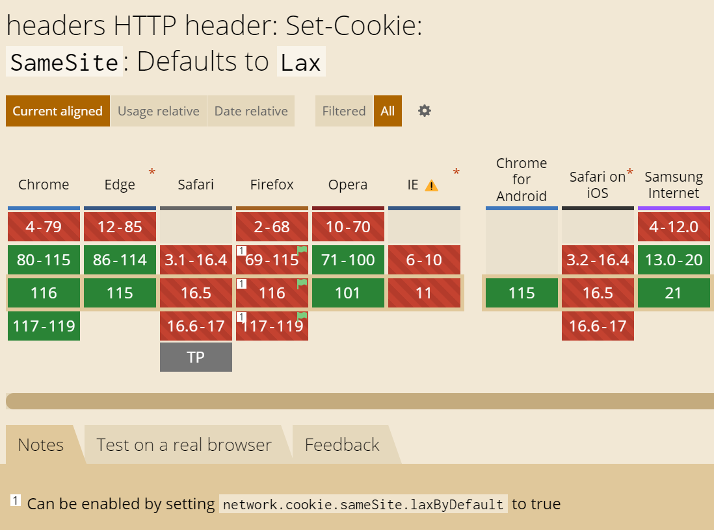
Browser default behaviour
https://caniuse.com/?search=samesite

Slide 57
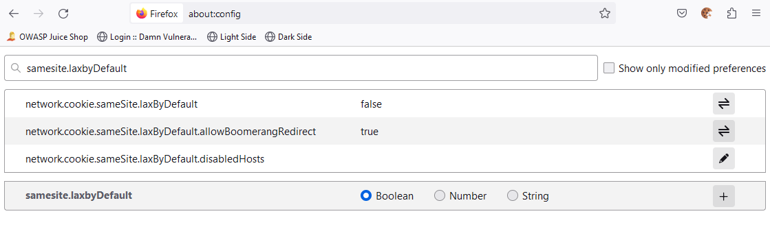
Can be manually enabled at Firefox

Slide 58
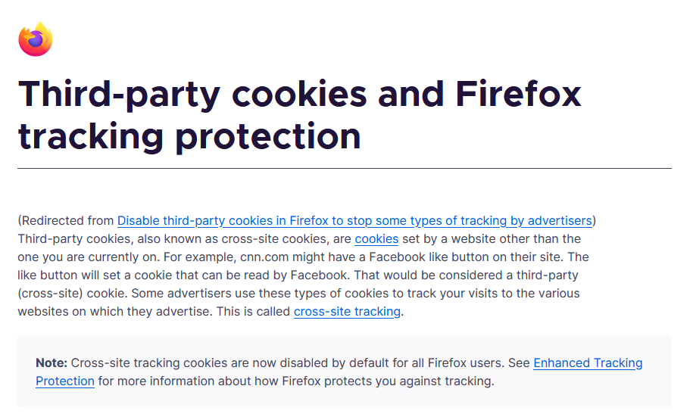
Additional Firefox feature influencing Cookie-handling
https://support.mozilla.org/en-US/kb/third-party-cookies-firefox-tracking-protection
Notes:
https://support.mozilla.org/en-US/kb/enhanced-tracking-protection-firefox-desktop
Cookies gelten immer nur für den direkten Seitenaufruf (also die URL in der Adresszeile)

Slide 59
Cross-Site Request Forgery (CSRF) | SQL Injection
Goal | Force user‘s browser to execute actions in the user‘s context but without the user‘s knowledge
How | Slip the user some html forms and abuse the fact that session tokens get appended automatically e.g. by phishing, forums, etc.
Solution | Synchronizer Token Pattern Server adds a random token to every form via hidden form field and checks this token in the user’s subsequent request Double Submit Pattern Server sets a random token as browser cookie. Client-side application adds it to every form/header. Server just needs to compare cookie and form-field/header. Actually works but has some pitfalls and is therefore not considered 100% secure Same-Site Flag Recommended: SameSite=Lax Complex Requests e.g. if server only accepts special content type (e.g. JSON), custom headers, etc.
OWASP Top 10
(Primary) Violated Principle
Notes:
Problems with Double-Submit Pattern: https://owasp.org/www-chapter-london/assets/slides/David_Johansson-Double_Defeat_of_Double-Submit_Cookie.pdf

Slide 60
Complex Requests as CSRF Protection
only works if you really check the content-type on the server side (e.g. application/json)
otherwise you can fake it:
<form method="POST" enctype="text/plain">
<input type="hidden" name='{"title":"' value='...","content": "..."}'>
</form>

Slide 61
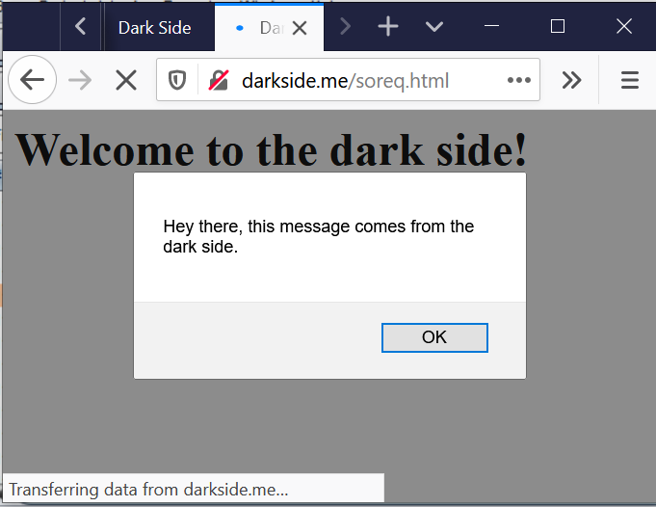
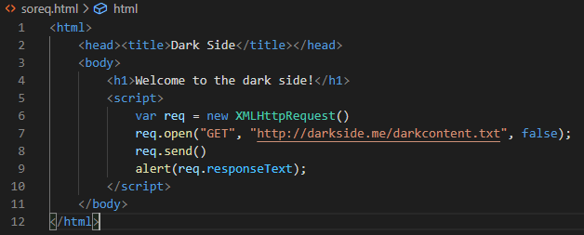




GET /darkcontent.txt HTTP/1.1
Host: darkside.me

Slide 62
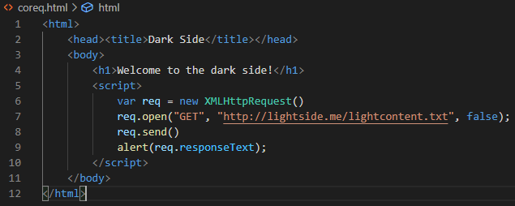
GET /coreq.html HTTP/1.1
Host: darkside.me

Slide 63
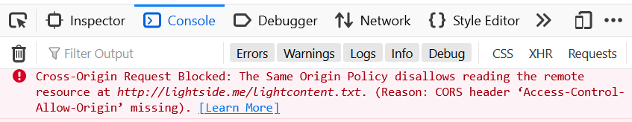



GET /lightcontent.txt HTTP/1.1
Host: lightside.me
HTTP/1.1 200 OK
...
Hey there, this message comes from
the light side.
who is this little helper?

Slide 64
Same Origin Policy
The web‘s basic security model
Basic idea:
Code from one origin (darkside.me) is not allowed to interfere with resources of another origin (lightside.me)
Origin = Protocol + Host + Port
http://darkside.me:80
http://lightside.me:80

Slide 65
Cross Origin Resource Sharing (CORS)
Sometimes applications just really want to communicate with other origins
If the other origin is fine with it, why not…
Just define a CORS header
To allow a specific origin to read data
Access-Control-Allow-Origin: http://darkside.me
To allow any origin to read data
Access-Control-Allow-Origin: *

Slide 66
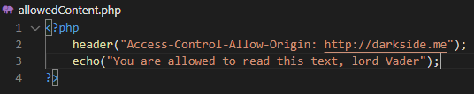
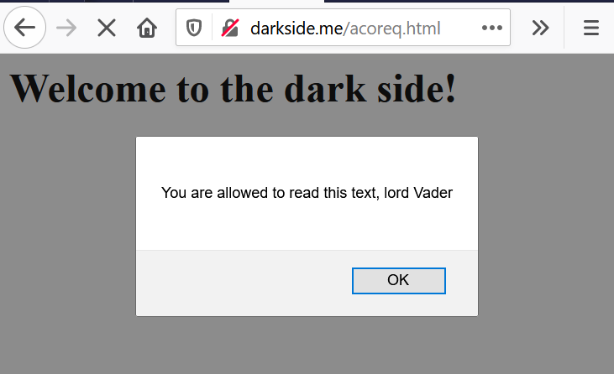
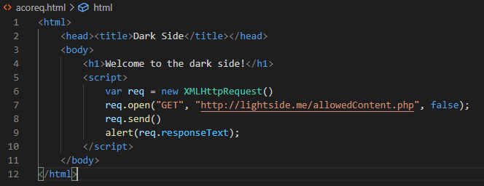
GET /allowedContent.php HTTP/1.1
Host: lightside.me
HTTP/1.1 200 OK
Access-Control-Allow-Origin: http://darkside.me
...
You are allowed to read this text, lord Vader
Notes:
https://developer.mozilla.org/de/docs/Web/HTTP/CORS:
Bei folgenden Methoden gibt’s einen „preflight“ request um vorher schon zu klären ob es erlaubt ist:
PUT
DELETE
CONNECT
OPTIONS
TRACE
PATCH

Slide 67
Key messages
Use TLS for your whole application
Store your passwords securely (bcrypt, PBKDF2,…)
Provide multi factor support and enforce it for critical areas
Secure your SID
Never trust the client or anything originating from the client

Slide 69
Forceful Browsing | SQL Injection
Goal | Directly call a URL / function which you‘re not supposed to by the ui
How | information gathering by client source code logs error messages robots.txt other users with higher privileges hacker instinct / guessing ;-)
Solution | NEVER rely on (client-side) frontend check user’s authorization for function/resource on server-side use unguessable IDs (e.g. UUIDs) as 2nd line of defense
OWASP Top 10 | A01:2021-Broken Access Control
(Primary) Violated Principle | „Earn or give, but never assume, trust.“ „Authorize after you authenticate“

Slide 70
client-side authorization checks yay or nay?
not relevant for security
security needs server side authorization checks
as an addition good for
usability – faster feedback
alerting
if server-side checks are mirrored at the frontend, every negative authorization decision at the backend is a strong indicator for an attack

Slide 71
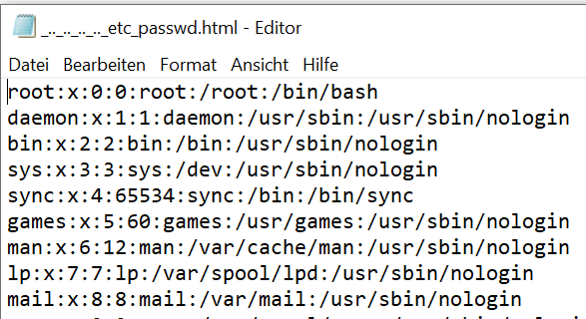
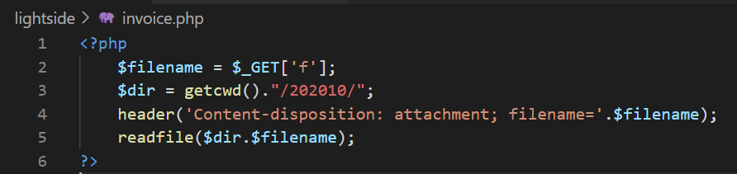
GET /invoice?f=../../../../../etc/passwd HTTP/1.1
Host: lightside.me
Notes:
TODO: um encoding-spielereien ergänzen

Slide 72
Path Traversal | SQL Injection
Goal | Directly access files (outside the webroot) which you‘re not supposed to by the application
How | whenever an application handles path’s incorrectly, try to iterate through it
Solution | Don’t use user input in filesystem APIs If you have to validate it (explicit allowlist) check the canonicalized path Run webserver under a low privileged user
OWASP Top 10 | A01:2021-Broken Access Control
(Primary) Violated Principle | “Define an approach that ensures all data are explicitly validated.”

Slide 73
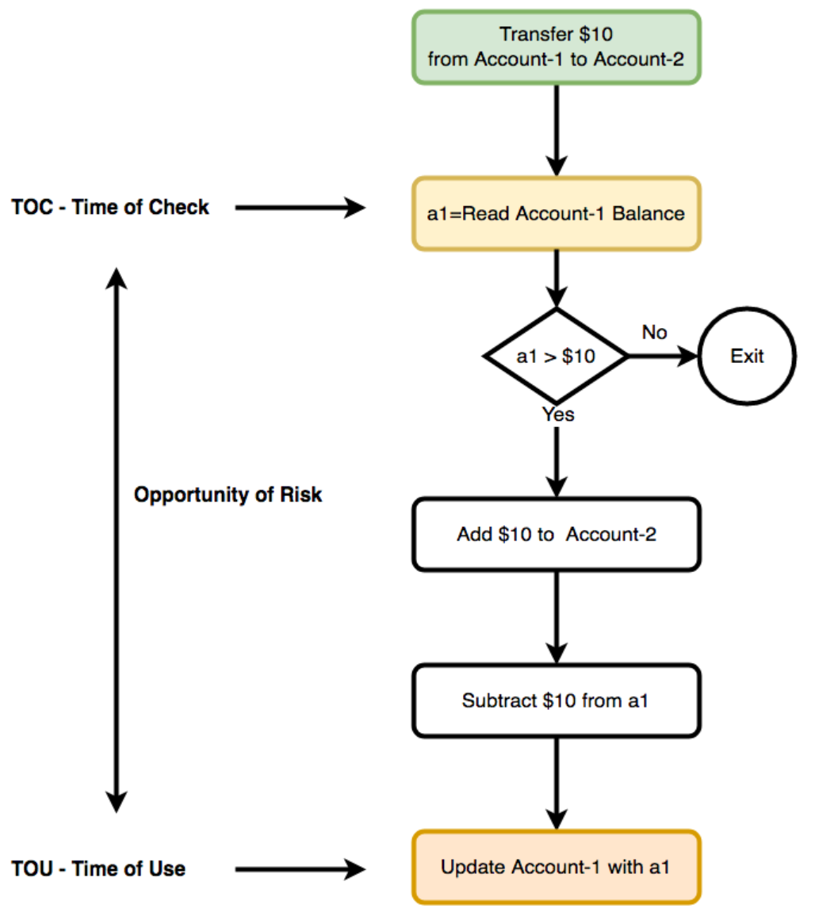
https://medium.com/@schogini/toctou-time-of-check-and-time-of-use-a-demonstration-and-mitigation-609c999042cb

Slide 74
Golden Authorization Rules
Always check everything for authorization
every request
every function call
every resource access
every everything
NEVER ever trust the client!
always check authorization on server side

